Slide 1
Congestion Control
CS 168 – Fall 2017 – Section 11

Slide 2
Reminders
Start Project 3!

Slide 3
Agenda
Once Upon a Time...
Congestion Control

Slide 4
October 1986

Slide 5
TCP Circa 1986
What happens when buffers fill up?
They get dropped
Then what happens at the sender?
Increased RTT, timeouts, retransmits
→More Packets in the network!!
… So more retransmits!
Eventually, useful throughout approaches zero
This is the congestion collapse of 1986!

Slide 6
Congestion Control!

Slide 7
Goal of Congestion Control
Limit the # of packets in flight
Utilize our fair share of bandwidth…
But don’t overload the network
Adapt to the right bandwidth
Be fair
Links are shared among many hosts

Slide 8
Congestion Control: Windows
Receive Window (RWND)
What rate at which the receiver can process packets
Congestion Window (CWND)
What rate at which the network can process packets
Sending rate
Smaller of the two
In this class, we assume CWND << RWND
Network will determine our sending rate

Slide 9
TCP Sawtooth
3 Dup ACKs
3 Dup ACKs
Timeout
CWND
Time
Congestion Avoidance/
Fast Recovery
Slow Start

Slide 10
Three States
Slow Start
Congestion Avoidance
Fast Recovery
3 Dup ACKs
3 Dup ACKs
Timeout
CWND
Time
Slow Start
Congestion Avoidance/
Fast Recovery

Slide 11
Congestion Control Mechanics
Slow Start
Rapidly increase our initial sending rate until we hit bottleneck
Congestion Avoidance
Adapting our sending rate to current network conditions
AIMD
Fast Recovery
Optimizing recovery from isolated loss
Detected through Duplicate ACKs

Slide 12
The Big Picture
timeout
slow start
congstn. avoid.
new ACK
dupACK
cwnd > ssthresh
timeout
new ACK
dupACK
timeout
new ACK
dupACK=3
dupACK=3
fast recovery
dupACK

Slide 13
Implementation
State at sender
CWND
Max sending rate without congesting network (assuming CWND << RWND)
Ssthresh
Threshold CWND for exiting slow start
dupACKcount
Count of contiguous duplicate ACKs received
timer

Slide 14
Implementation
Events at sender
ACK (new data)
dupACK (duplicate ACK for old data)
Timeout
… receiver just receives packets and sends ACKs

Slide 15
Now the Details
Thanks Alex Triana, our amazing F’15 TA!

Slide 16
Slow Start -- Intuition
Instead of blasting packets based on the receive window
Build up initial transmission rate slowly
Back off when we’ve exceeded the capacity

Slide 17
Slow Start
Value of CWND starts at (small constant) * MSS
For each packet that is acknowledged, increase the CWND by 1
Effectively doubles CWND every RTT!
Window goes from 1 → 2 → 4 → …

Slide 18
Slow Start – When Does It End?
2 Ways
If CWND > ssthresh
Enter congestion avoidance
If we get 3 duplicate ACKs
Enter Fast Recovery
If timeout:
Restart slow start, ssthresh = cwnd/2, CWND = 1

Slide 19
DupACK
- DupAckCount++
Timeout
ssthresh = cwnd / 2
cwnd = 1
dupAckCount = 0
New ACK
cwnd = cwnd + 1
dupAckCount = 0
Slow Start
dupAckCount == 3
Move to Fast Recovery
sshtresh = cwnd / 2
cwnd = ssthresh + 3
Retransmit missing packet
cwnd > ssthresh
Move to Congestion Avoidance

Slide 20
Congestion Avoidance -- Intuition
In the steady state
Constantly probe for more bandwidth
When we’ve exceeded – back off aggressively

Slide 21
Congestion Avoidance
Growth is more conservative than slow start
After each new ACK, increase CWND by 1 / CWND
After one RTT, CWND will have increased by ~1
When does it stop?
Timeout → back to slow start
3 duplicate ACKS → Fast recovery

Slide 22
DupACK
-DupAckCount++
New ACK
cwnd = cwnd + 1/cwnd
dupAckCount = 0
Congestion Avoidance
Timeout
Move to Slow Start
ssthresh = cwnd / 2
cwnd = 1
- dupAckCount = 0
dupACKCount == 3
Move to Fast Recovery
sshtresh = cwnd / 2
cwnd = ssthresh + 3
Retransmit missing packet

Slide 23
Fast Recovery — Intuition
A single lost packet
May just be a fluke
Resetting cwnd may be too aggressive
Instead just retransmit that single packet
And continue as if nothing happened

Slide 24
Fast Recovery
Every duplicate ACK increases the window by 1
When does it stop?
Timeout → back to Slow Start
New ACK → back to Congestion Avoidance

Slide 25
New ACK
Move to Congestion Avoidance
cwnd = ssthresh
dupAckCount = 0
Timeout
Move to Slow Start
- ssthresh = cwnd / 2
- cwnd = 1
- dupAckCount = 0
Fast Recovery
DupACK
- cwnd = cwnd + 1

Slide 26
Big Ideas
Fundamental concepts:
Slow Start
AIMD
Hack
Fast Recovery
Lesson
Sometimes, BAND-AIDs scale remarkably well!

Slide 27
End of section slides
Notes:
TAs: feel free to use subsequent slides for worksheet.

Slide 28
Worksheet
Problem 2:
“On new ACK, CWND = CWND + 1 / Floor(CWND)
On triple duplicate ACKs, SSHTHRESH = Floor(CWND/2)”
Problem 3: Derivation Video by Alex Triana
https://www.youtube.com/watch?v=Y1I4dG48byg

Slide 29
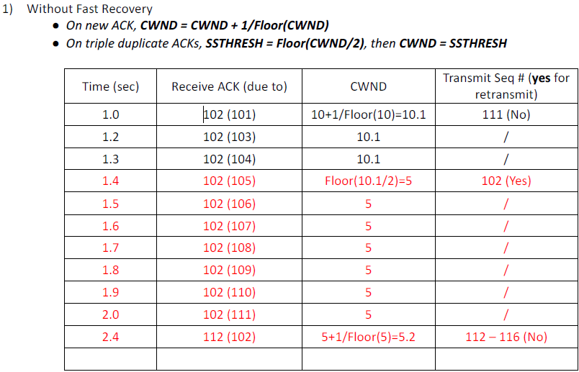

Slide 30
Ssthresh=5

Slide 31
Ssthresh=5

Slide 32
Ssthresh=5

Slide 33
Ssthresh=5

Slide 34
Ssthresh=5

Slide 35
Ssthresh=5

Slide 36
Ssthresh=5

Slide 37
Ssthresh=5

Slide 38
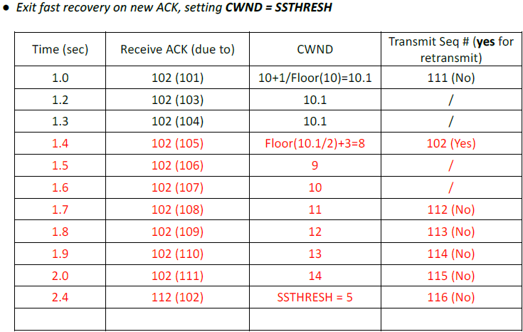

Slide 39
Ssthresh=5

Slide 40
Ssthresh=5

Slide 41
Ssthresh=5

Slide 42
Ssthresh=5

Slide 43
Ssthresh=5

Slide 44
Ssthresh=5

Slide 45
Ssthresh=5

Slide 46
Ssthresh=5

